Slide 1
Data Science 2018

Slide 2
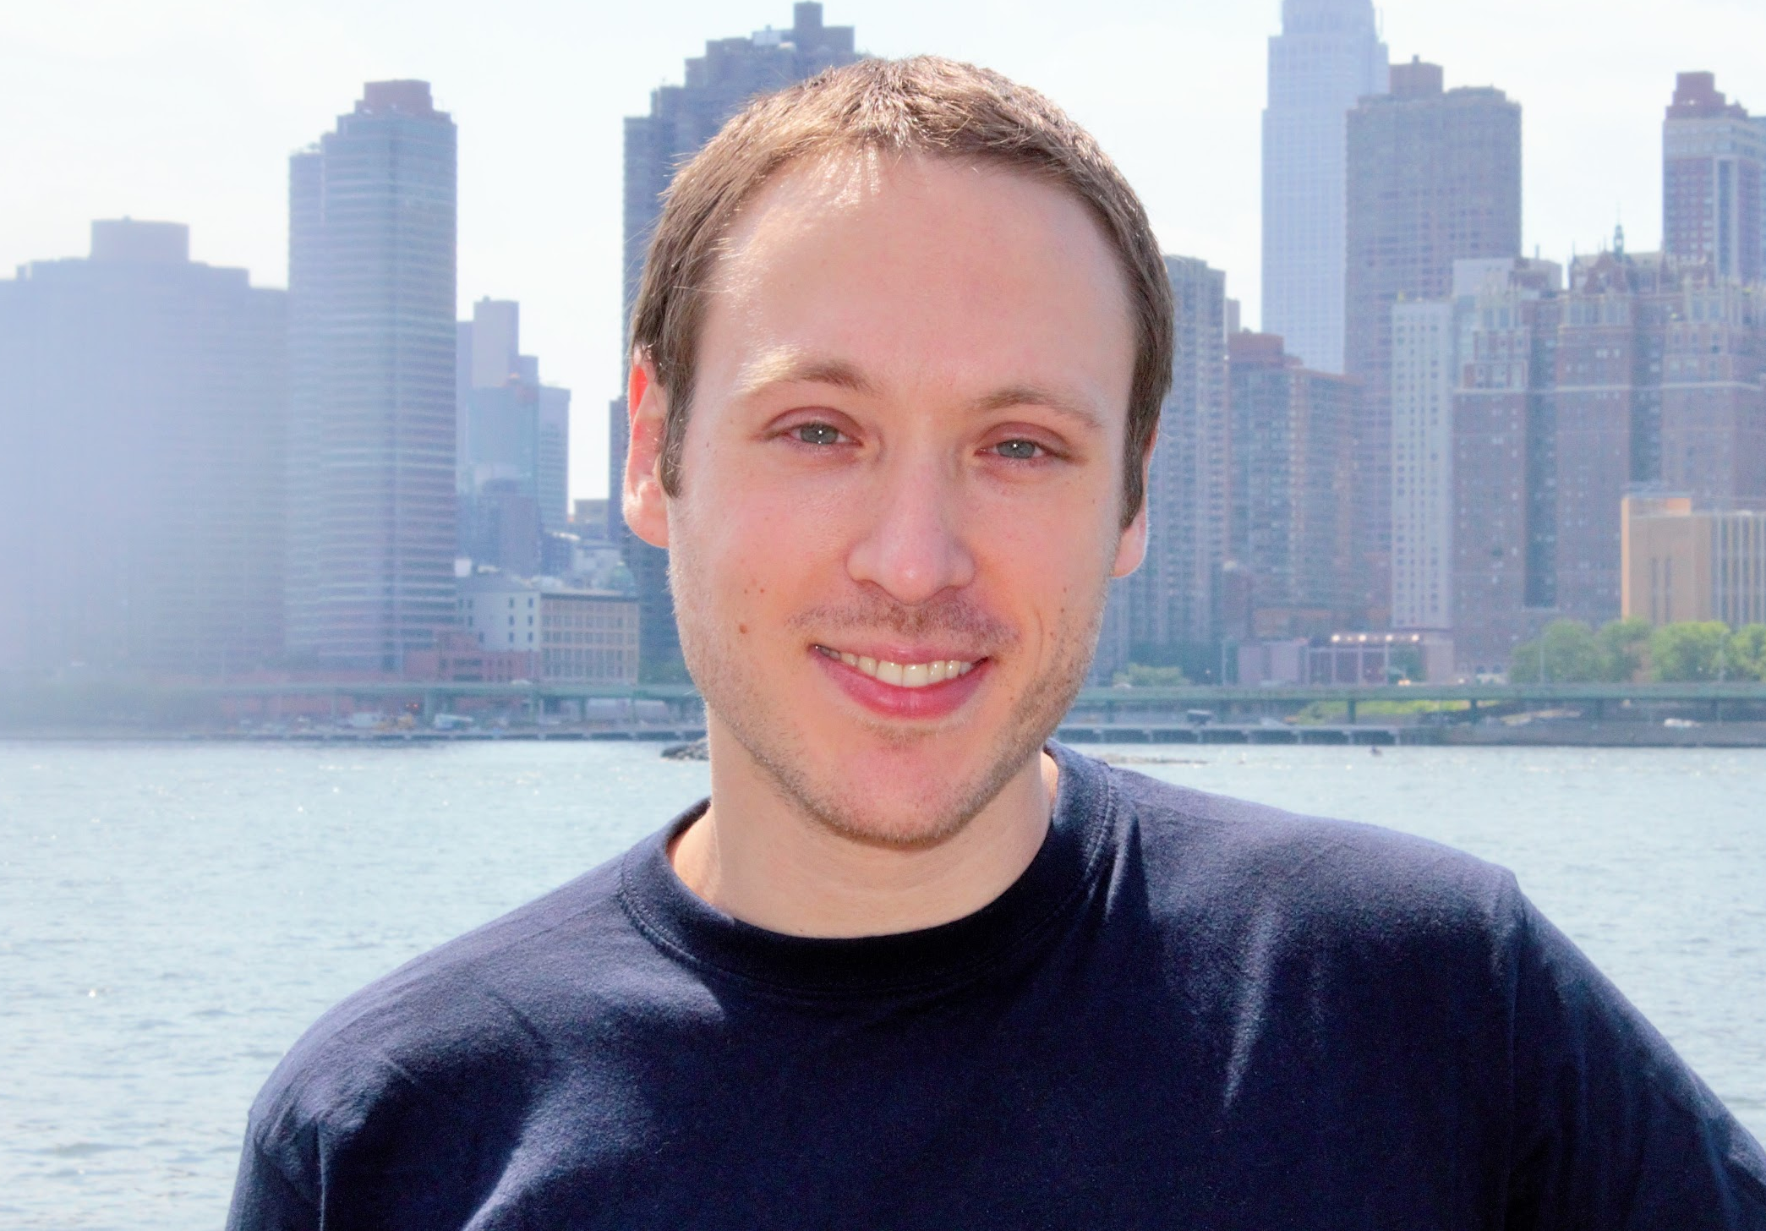
About me (Manuel Garrido)
Data Scientist
CTO @ TribeClick and Professor at Lisbon Data Science Academy and ENAE
Consultant → Analyst → Data Scientist Excel - Excel VBA - R - Python manugarri.com hola@manugarri.com

Slide 3
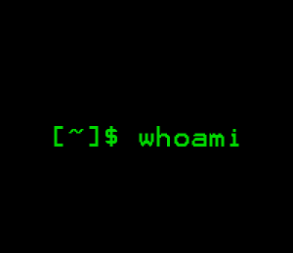

About me (Sean Wade)
Student BYU researching Reinforcement Learning
Applied Math Undergrad
Drone Computer Vision for MIT Lincoln Labs and Loveland Innovations -> ML Engineer for Disney
seanwade.com

Slide 4
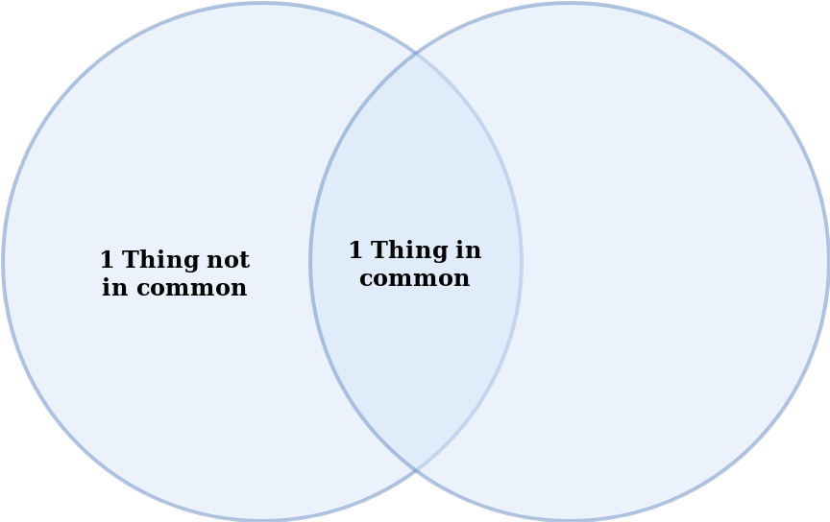
About you
In groups of 4 , introduce to each other find one thing in common and one thing you don’t

Slide 5
About the program
Topics covered in this program:
Programming in Python
Unix
3. Exploratory Data Analysis
4​. ​ Data Visualization
5. Statistics
6. Machine Learning
Practical Program, with just the necessary amount of math.
Challenging, but let us know if it’s too easy/hard
Some computing power required.
Participation is encouraged (No stupid questions, No wrong answers).
Internship information will roll in on week 2
Enjoy Lisbon!

Slide 6
Intro to Python

Slide 7

Python Facts
Programming Language created by Guido Van Rossum in 1991
Developed by the Python Software Foundation
Interpreted, object oriented language
Focus on readability and “batteries included”
Current version: 3.6.5
¿Python 2 or Python 3?

Slide 8
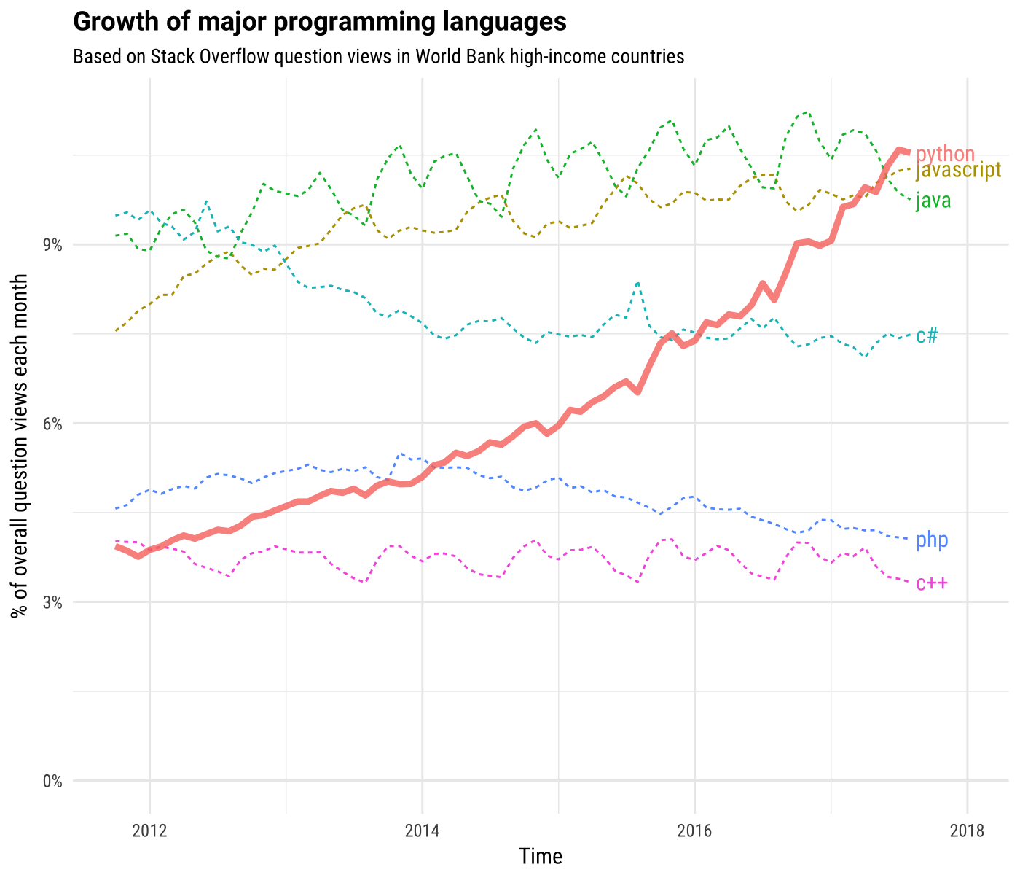
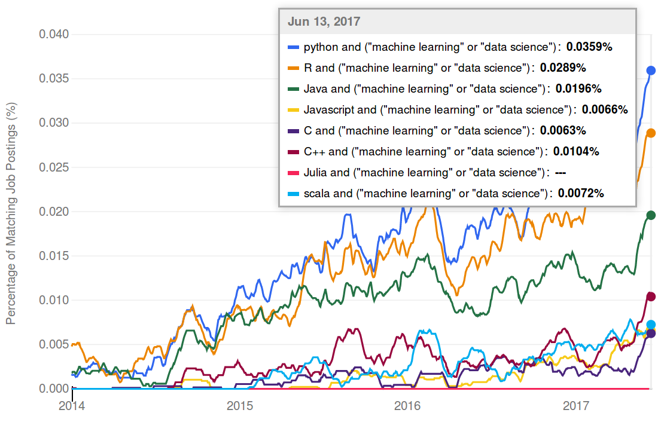
Python for Data Science
Notes:
http://www.kdnuggets.com/2017/01/most-popular-language-machine-learning-data-science.html
Indeed
https://stackoverflow.blog/2017/09/06/incredible-growth-python/

Slide 9
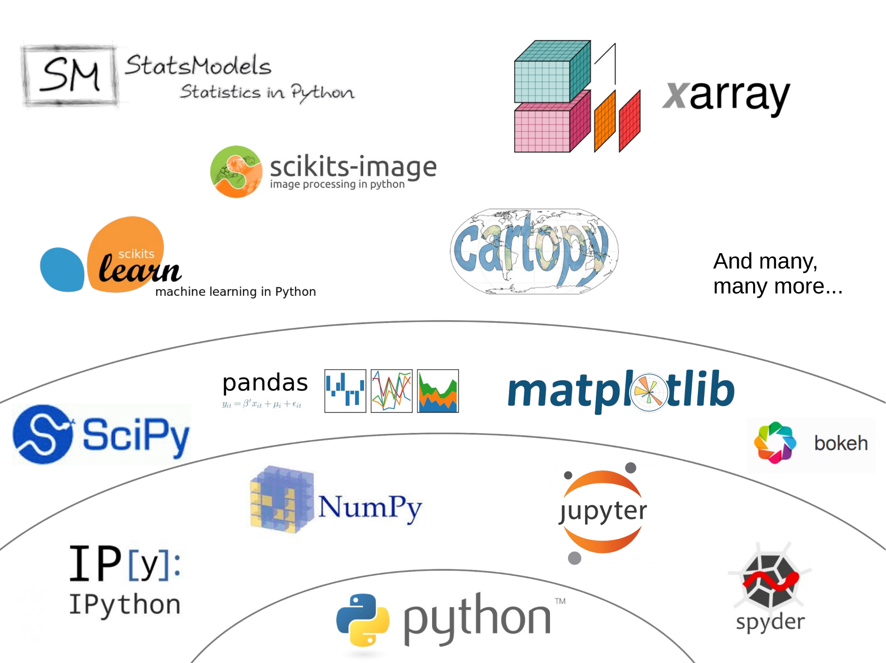

Slide 10
How to find help
Ask your instructors
¡Google!
Stack Overflow
- Reddit (/r/learnprogramming or /r/learnpython)
IRC (#python channel)

Slide 11
Show time!

